Slide 1
NoteBook
A 4th Semester Project

Slide 2
PRESENTED BY :-
Ankit Rana Sakshi Agarwal Pallab Manchanda
11192525 11192516 11192514
A2 A2 A2

Slide 3
What is NoteBook ?
NoteBook is a website which aims to make the process of sharing and uploading of notes and study material a seamless and linear process for the Engineering students of Maharishi Markandeshwar (Deemed to be University)

Slide 4
What are the advantages of NoteBook ?
Has a User Friendly interface
Provides a platform to share Study Material
Provides an environment outside of classroom to discuss and review assignments and notes
Account creation and file saving system
Fast download via server

Slide 5
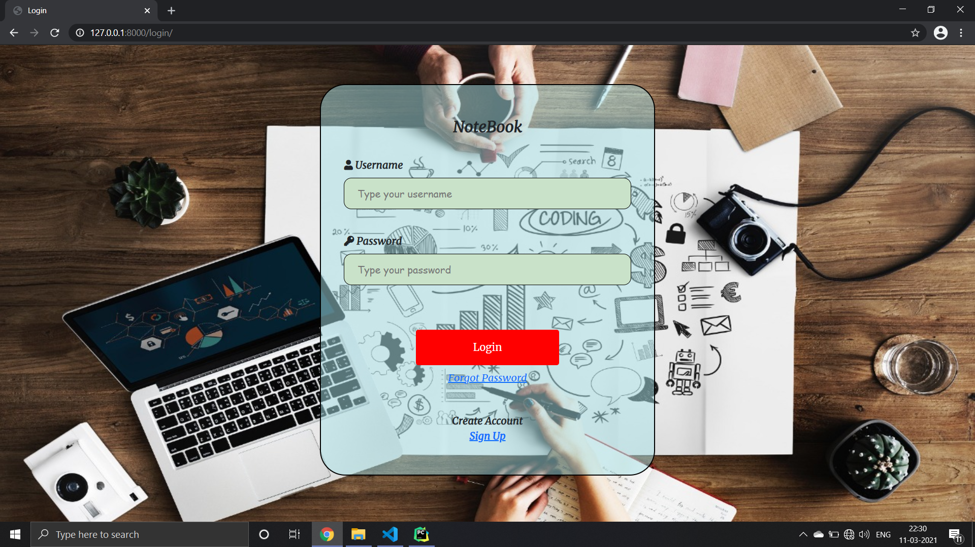
Login Page Preview

Slide 6
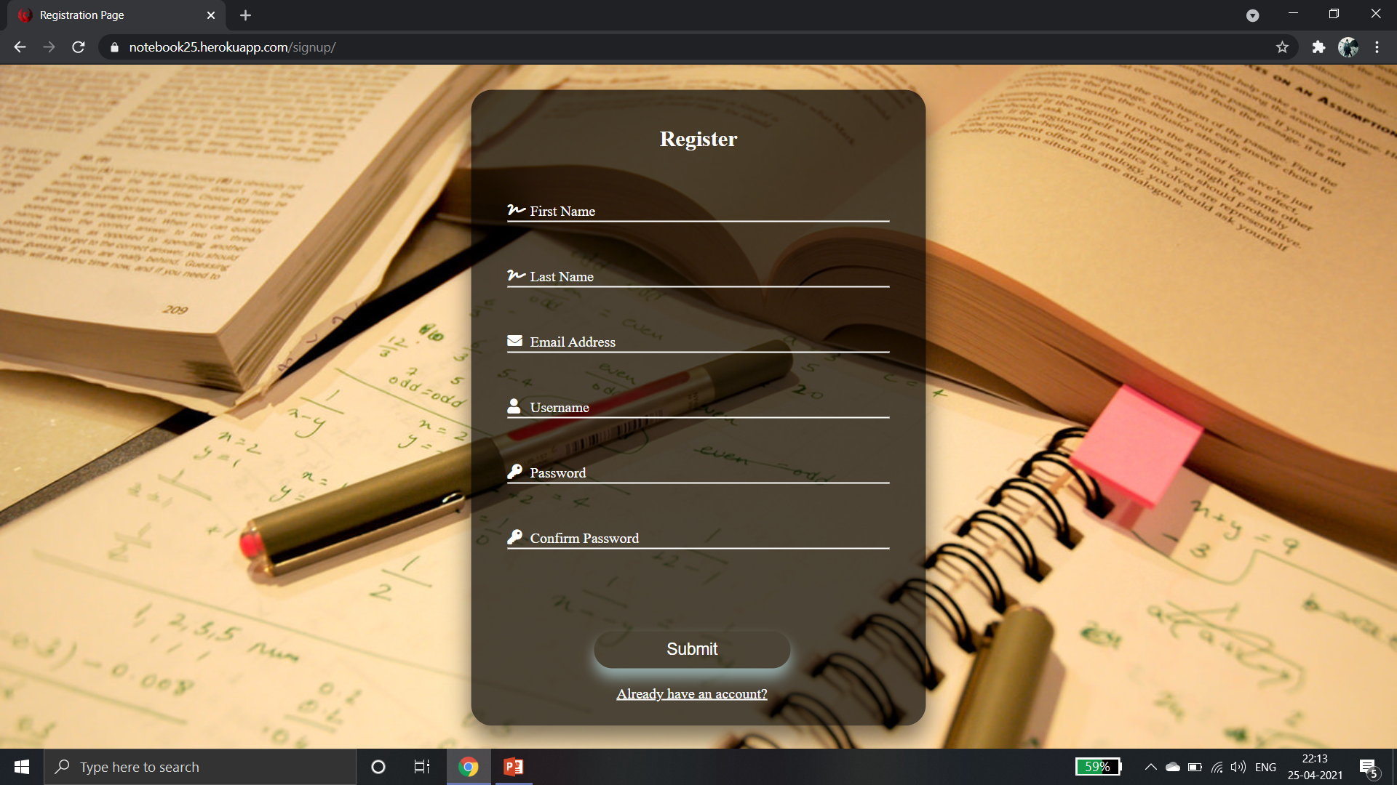
Account Creation Page

Slide 7
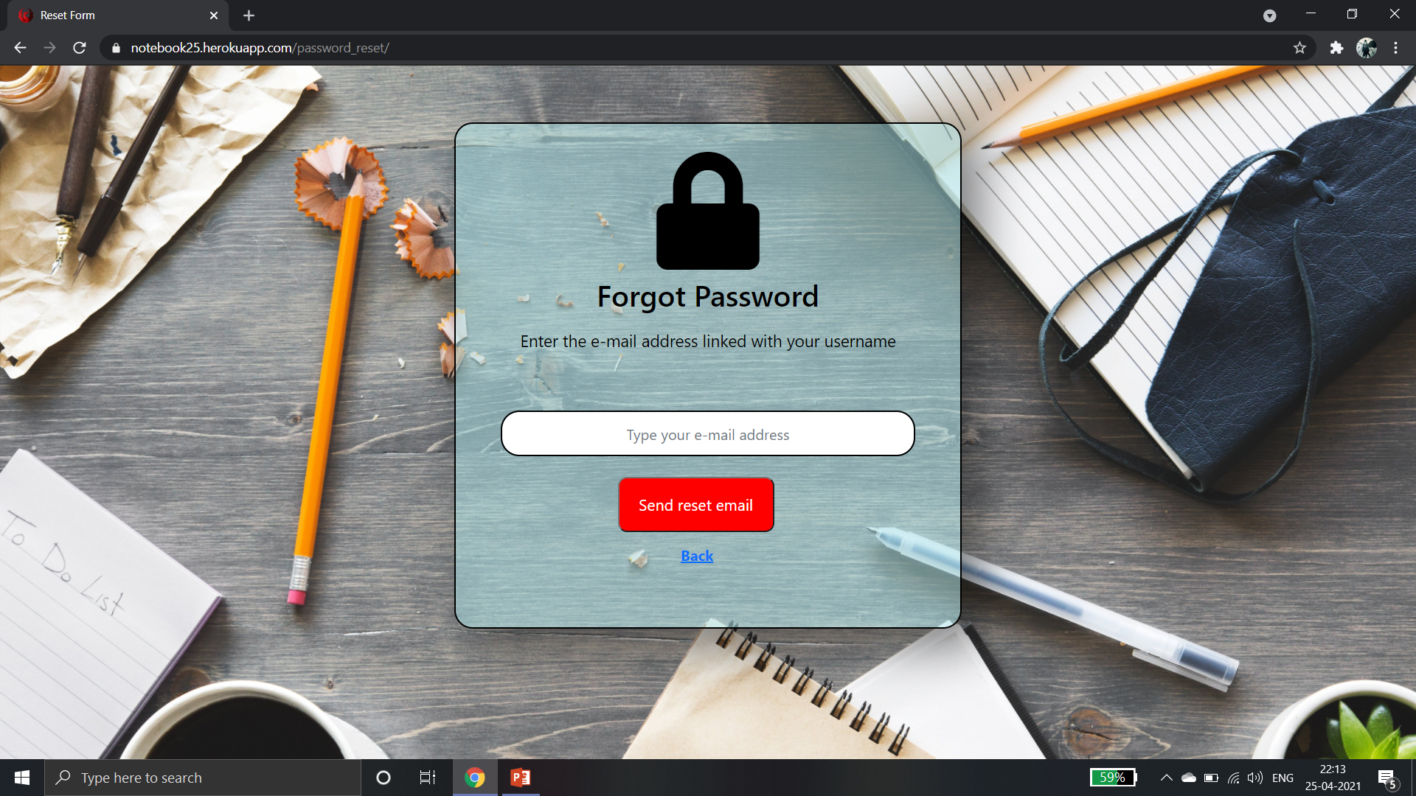
Forgot Password Page

Slide 8
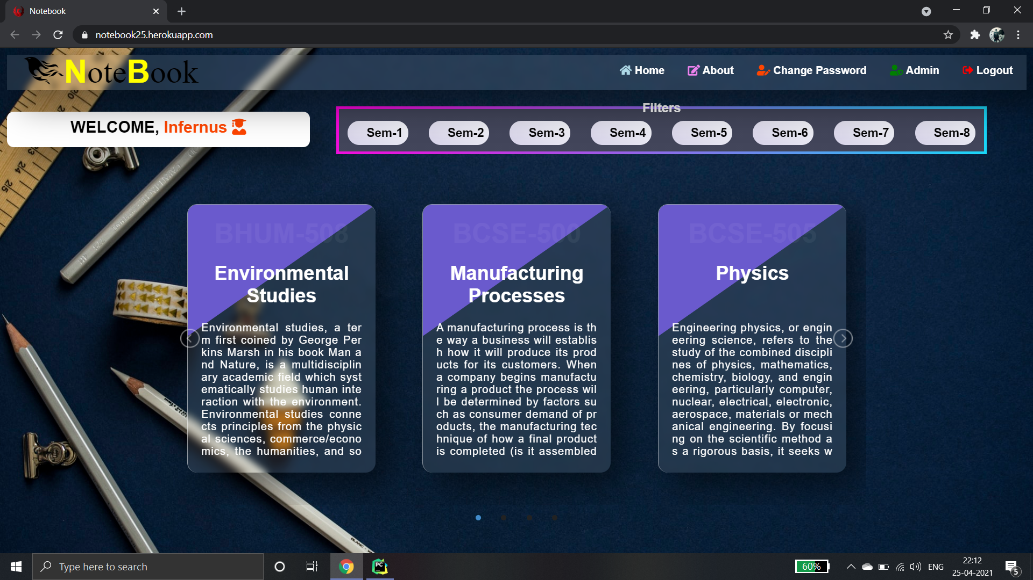
Home Page Template

Slide 9
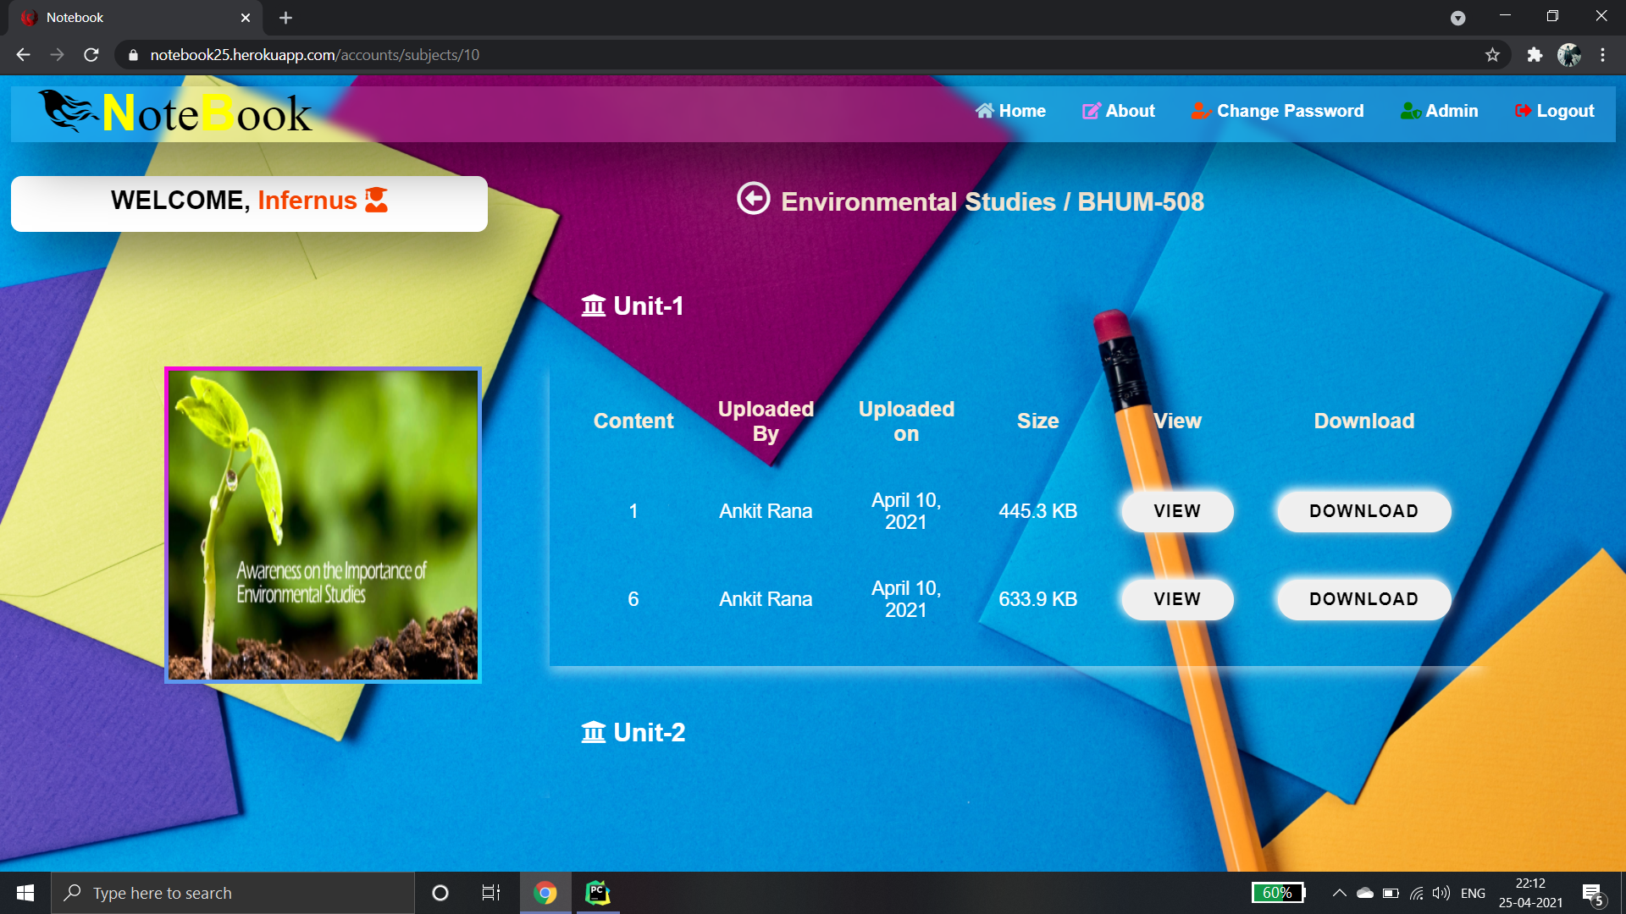
Notes Page

Slide 10
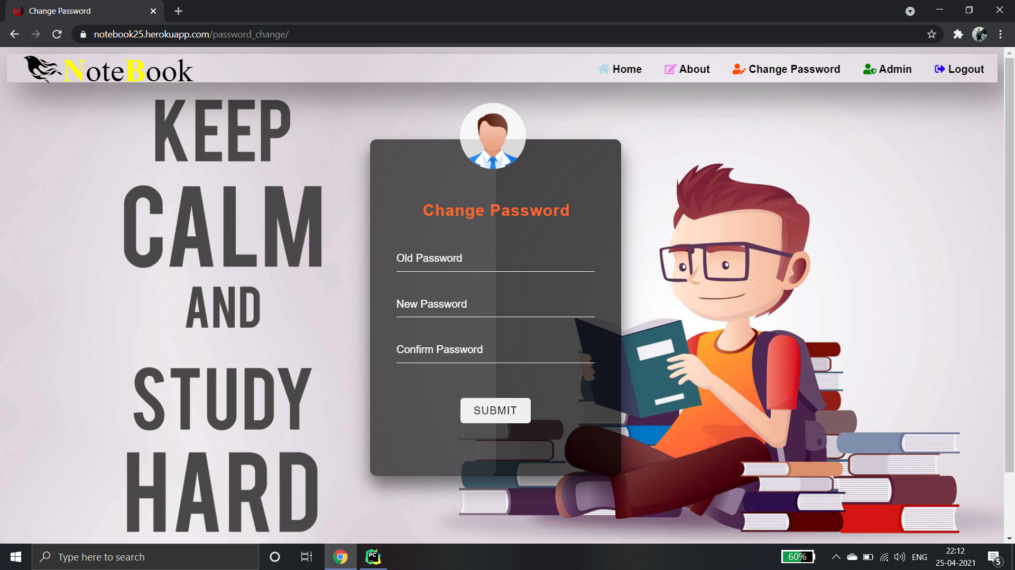
Change Password Page

Slide 11
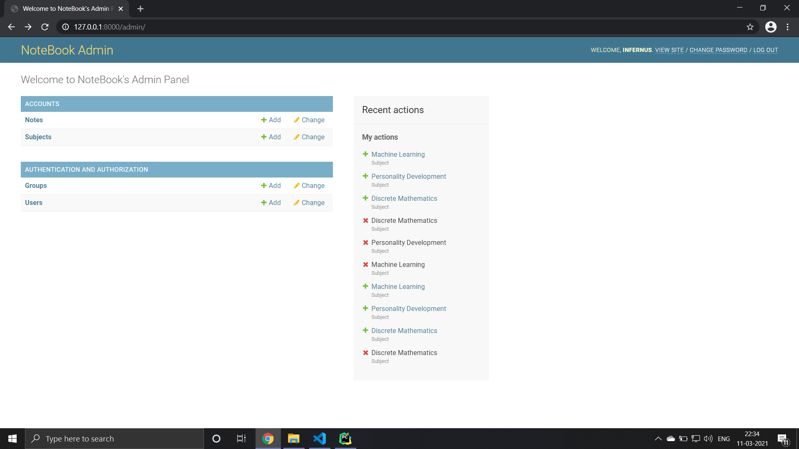
Admin Page Preview

Slide 12
THANK YOU
Submitted To :- Puneet Banga

